Slide 1
Relational Algebra and SQL

Slide 2
Relational Query Languages
Languages for describing queries on a relational database
Structured Query Language (SQL)
  Predominant application-level query language
  Declarative
Relational Algebra
  Intermediate language used within DBMS
  Procedural

Slide 3
What is an Algebra?
A language based on operators and a domain of values
Operators map values taken from the domain into other domain values
Hence, an expression involving operators and arguments produces a value in the domain
When the domain is a set of all relations (and the operators are as described later), we get the relational algebra
We refer to the expression as a query and the value produced as the query result

Slide 4
Relational Algebra
Domain: set of relations
Basic operators: select, project, union, set difference, Cartesian product
Derived operators: set intersection, division, join
Procedural: Relational expression specifies query by describing an algorithm (the sequence in which operators are applied) for determining the result of an expression

Slide 5
Relational Algebra in a DBMS
Optimized
Relational
algebra
expression
Relational
algebra
expression
Query
execution
plan
Executable
code
SQL
query
Code
generator
parser
Query optimizer
DBMS

Slide 6
Select Operator
Produce table containing subset of rows of argument table satisfying condition
σ_{condition} relation
Example:
Person σ_{Hobby=‘stamps’}(Person)
Id Name Address Hobby
Id Name Address Hobby
1123 John 123 Main stamps
1123 John 123 Main coins
5556 Mary 7 Lake Dr hiking
9876 Bart 5 Pine St stamps
1123 John 123 Main stamps
9876 Bart 5 Pine St stamps

Slide 7
Selection Condition
Operators: <, ≤, ≥, >, =, ≠
Simple selection condition:
  <attribute> operator <constant>
  <attribute> operator <attribute>
<condition> AND <condition>
<condition> OR <condition>
NOT <condition>

Slide 8
Selection Condition - Examples
σ _{Id>3000 Or Hobby=‘hiking’} (Person)
σ _{Id>3000 AND Id <3999} (Person)
σ _{NOT(Hobby=‘hiking’)} (Person)
σ _{Hobby≠‘hiking’} (Person)

Slide 9
Project Operator
Produces table containing subset of columns of argument table
  Π_{attribute list}(relation)
Example:
  Person Π_{Name,Hobby}(Person)
Id Name Address Hobby Name Hobby
1123 John 123 Main stamps
1123 John 123 Main coins
5556 Mary 7 Lake Dr hiking
9876 Bart 5 Pine St stamps
John stamps
John coins
Mary hiking
Bart stamps

Slide 10
Project Operator
Example:
  Person Π_{Name,Address}(Person)
Id Name Address Hobby
Name Address
1123 John 123 Main stamps
1123 John 123 Main coins
5556 Mary 7 Lake Dr hiking
9876 Bart 5 Pine St stamps
John 123 Main
Mary 7 Lake Dr
Bart 5 Pine St
Result is a table (no duplicates)

Slide 11
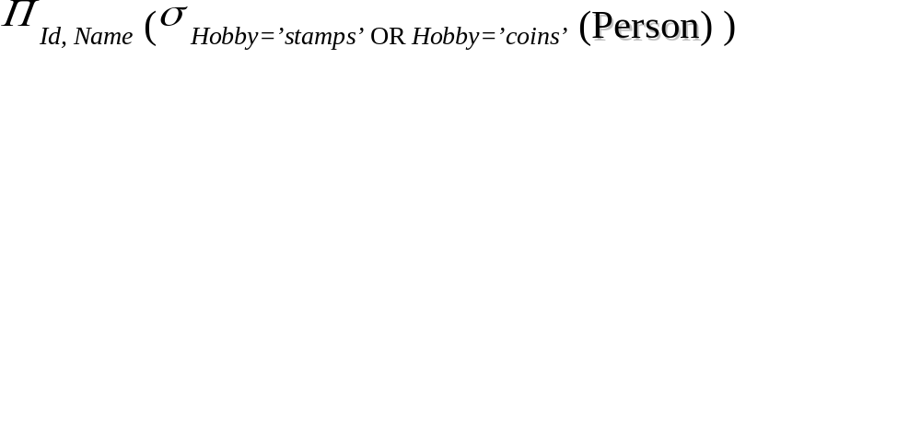
Expressions
Id Name Address Hobby Id Name
1123 John 123 Main stamps
1123 John 123 Main coins
5556 Mary 7 Lake Dr hiking
9876 Bart 5 Pine St stamps
1123 John
9876 Bart
Result
Person

Slide 12
Set Operators
Relation is a set of tuples => set operations should apply
Result of combining two relations with a set operator is a relation => all its elements must be tuples having same structure
Hence, scope of set operations limited to union compatible relations

Slide 13
Union Compatible Relations
Two relations are union compatible if
  Both have same number of columns
  Names of attributes are the same in both
  Attributes with the same name in both relations have the same domain
Union compatible relations can be combined using union, intersection, and set difference

Slide 14
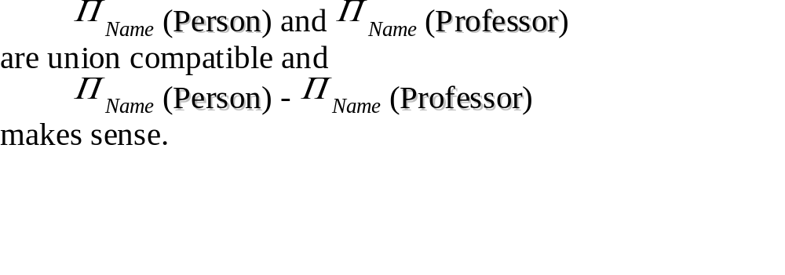
Example
Tables:
Person (SSN, Name, Address, Hobby)
Professor (Id, Name, Office, Phone)
are not union compatible. However

Slide 15
Cartesian Product
If R and S are two relations, R × S is the set of all concatenated tuples <x,y>, where x is a tuple in R and y is a tuple in S
  (R and S need not be union compatible)
R × S is expensive to compute:
  Factor of two in the size of each row
  Quadratic in the number of rows
a b c d a b c d
x1 x2 y1 y2 x1 x2 y1 y2
x3 x4 y3 y4 x1 x2 y3 y4
x3 x4 y1 y2
R S x3 x4 y3 y4
R× S

Slide 16
Renaming
Result of expression evaluation is a relation
Attributes of relation must have distinct names. This is not guaranteed with Cartesian product
  e.g., suppose in previous example a and c have the same name

Slide 17
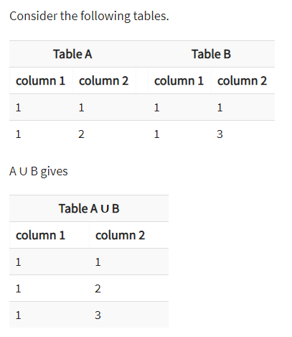
Union

Slide 18
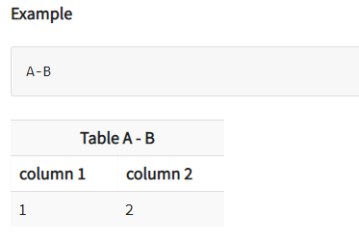
Set Difference
The result of A - B, is a relation which includes all tuples that are in A but not in B.

Slide 19
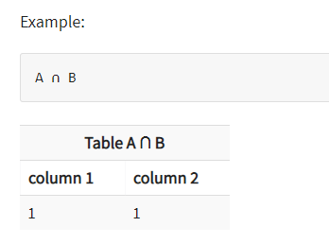
Intersection

Slide 20
JOINS
Inner Joins:
Theta join
EQUI join
Natural join
Outer join:
Left Outer Join
Right Outer Join
Full Outer Join

Slide 21
Inner Join
In an inner join, only those tuples that satisfy the matching criteria are included, while the rest are excluded.

Slide 22
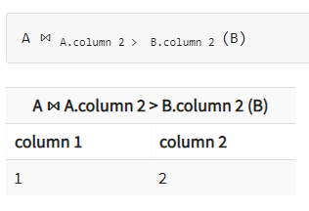

Theta Join
The general case of JOIN operation is called a Theta join. It is denoted by symbol θ.

Slide 23
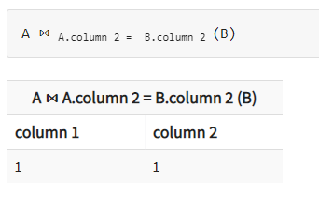
Equi Join
When a theta join uses only equivalence condition, it becomes a equi join.

Slide 24
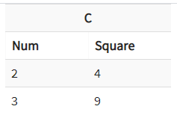
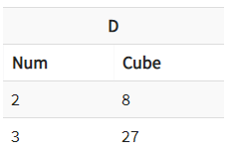
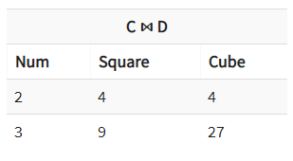
Natural Join
Natural join can only be performed if there is a common attribute (column) between the relations. The name and type of the attribute must be same.

Slide 25
Outer Join
In an outer join, along with tuples that satisfy the matching criteria, we also include some or all tuples that do not match the criteria.

Slide 26
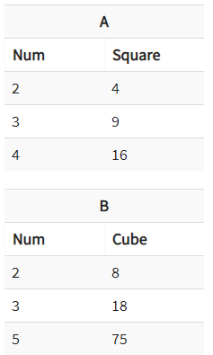
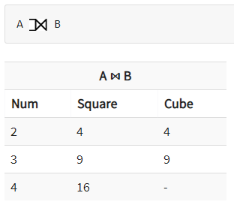
Left Outer Join
In the left outer join, operation allows keeping all tuple in the left relation. However, if there is no matching tuple is found in right relation, then the attributes of right relation in the join result are filled with null values.

Slide 27
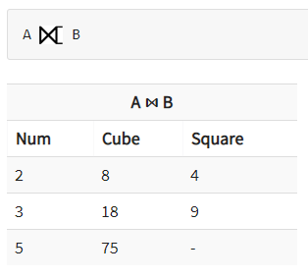
Right Outer Join
In the right outer join, operation allows keeping all tuple in the right relation. However, if there is no matching tuple is found in the left relation, then the attributes of the left relation in the join result are filled with null values.

Slide 28
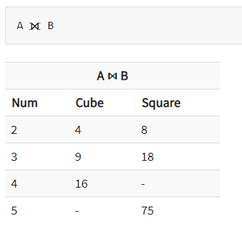
Full Outer Join
In a full outer join, all tuples from both relations are included in the result, irrespective of the matching condition.

Slide 29
Division
Useful for expressing “for all” queries like: Find sids of sailors who have reserved all boats.
For A/B attributes of B are subset of attrs of A.
  May need to “project” to make this happen.
E.g., let A have 2 fields, x and y; B have only field y:

Slide 30
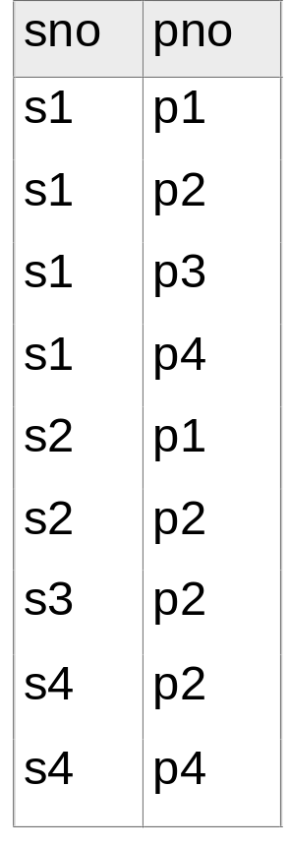
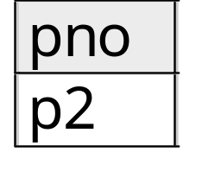
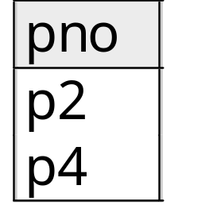
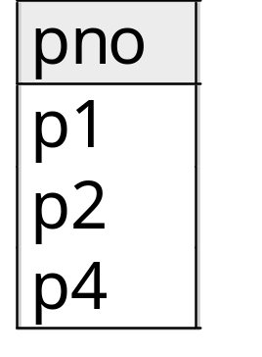
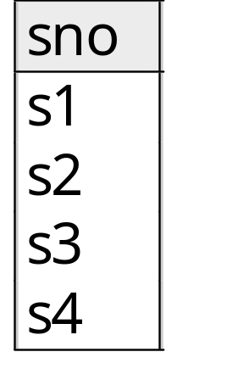
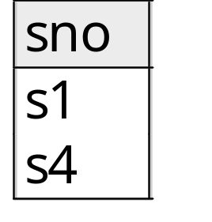
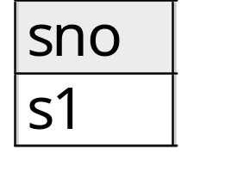
Examples of Division A/B
B1
B2
B3
A
A/B1
A/B2
A/B3

Slide 31
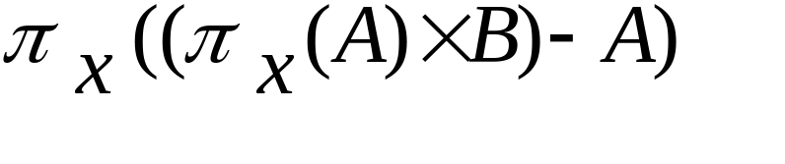
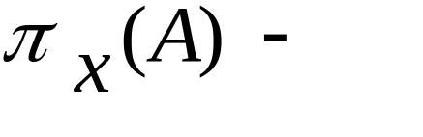
Division is not essential op; just a useful shorthand.
  (Also true of joins, but joins are so common that systems implement joins specially.)
Idea: For A/B, compute all x values that are not `disqualified’ by some y value in B.
  x value is disqualified if by attaching y value from B, we obtain an xy tuple that is not in A.
  Disqualified x values:
A/B:
Disqualified x values

Slide 32
Theta Join – Example
Output the names of all employees that earn
more than their managers.
Π_{Employee.Name} (Employee _{MngrId=Id AND Salary>Salary} Manager)
The join yields a table with attributes:
Employee.Name, Employee.Id, Employee.Salary, MngrId
Manager.Name, Manager.Id, Manager.Salary

Slide 33
Equijoin Join - Example
Equijoin: Join condition is a conjunction of equalities.
Π_{Name,CrsCode}(Student
_{Id=StudId} σ_{Grade=‘A’} (Transcript))
Student
Transcript
Id Name Addr Status
111 John ….. …..
222 Mary ….. …..
333 Bill ….. …..
444 Joe ….. …..
StudId CrsCode Sem Grade
111 CSE305 S00 B
222 CSE306 S99 A
333 CSE304 F99 A
The equijoin is used very
frequently since it combines
related data in different relations.
Mary CSE306
Bill CSE304

Slide 34
Natural Join
Special case of equijoin:
  join condition equates all and only those attributes with the same name (condition doesn’t have to be explicitly stated)
  duplicate columns eliminated from the result
Transcript (StudId, CrsCode, Sem, Grade)
Teaching (ProfId, CrsCode, Sem)
Transcript
Teaching =
πStudId, Transcript.CrsCode, Transcript.Sem, Grade, ProfId (
Transcript
_{CrsCode=CrsCode AND Sem=Sem}Teaching)
[StudId, CrsCode, Sem, Grade, ProfId ]

Slide 35
Natural Join (con’t)
More generally:
R
S = π_{attr-list} (σ_{join-cond} (R × S) )
where
attr-list = attributes (R) ∪ attributes (S)
(duplicates are eliminated) and join-cond has
the form:
A₁ = A₁ AND … AND A_{n} = A_{n}
where
{A₁ … A_{n}} = attributes(R) ∩ attributes(S)

Slide 36
Natural Join Example
List all Id’s of students who took at least two different courses:
Π_{StudId} ( σ_{CrsCode ≠ CrsCode2} (
Transcript
Transcript [StudId, CrsCode2, Sem2, Grade2]))
(don’t join on CrsCode, Sem, and Grade attributes)

Slide 37
Division
Goal: Produce the tuples in one relation, r, that match all tuples in another relation, s
  r (A₁, …A_{n}, B₁, …B_{m})
  s (B₁ …B_{m})
  r/s, with attributes A₁, …A_{n}, is the set of all tuples <a> such that for every tuple <b> in s, <a,b> is in r
Can be expressed in terms of projection, set difference, and cross-product

Slide 38
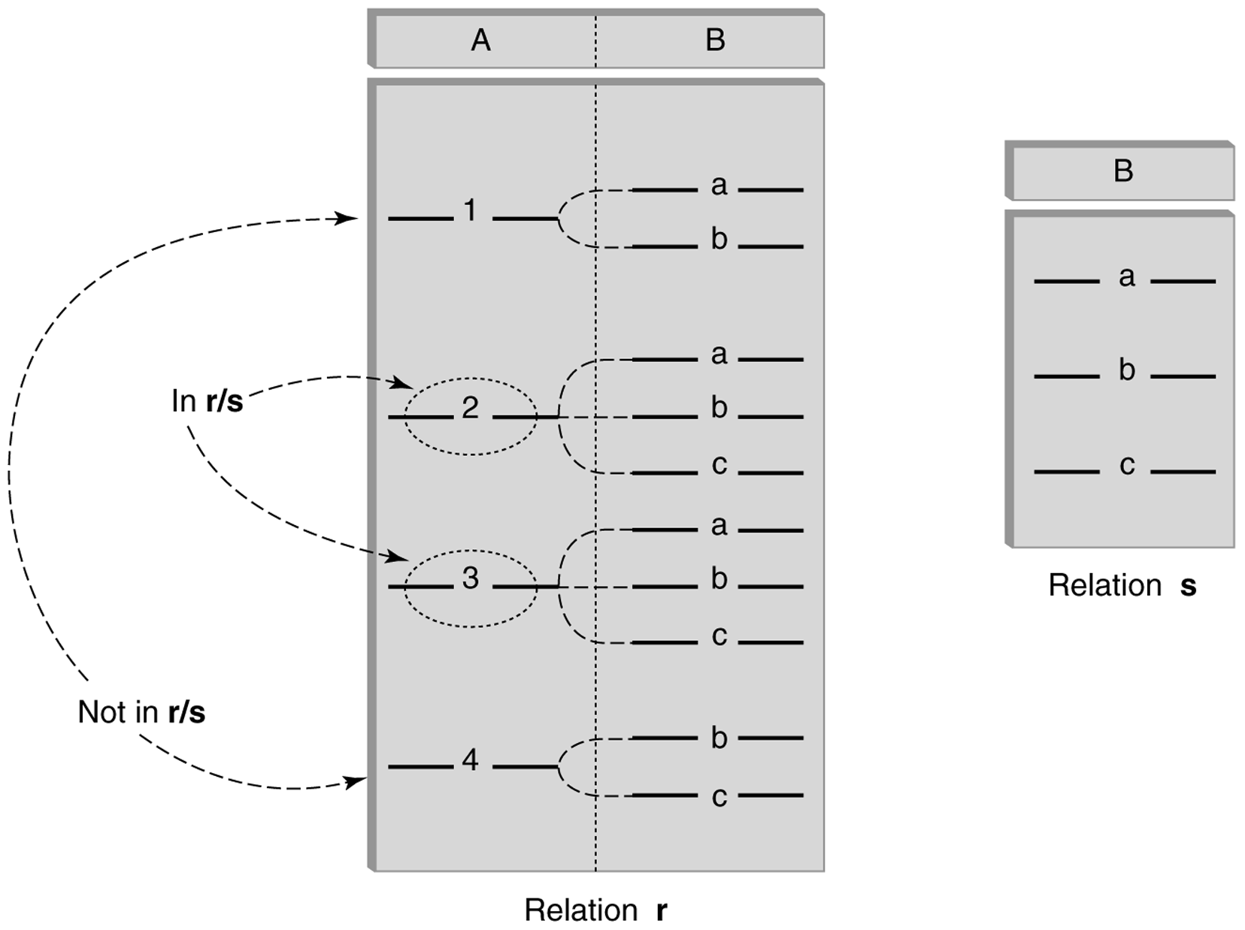
Division (con’t)

Slide 39
Division - Example
List the Ids of students who have passed all courses that were taught in spring 2000
Numerator: StudId and CrsCode for every course passed by every student
  π_{StudId, CrsCode} (σ_{Grade≠ ‘F’} (Transcript) )
Denominator: CrsCode of all courses taught in spring 2000
  Π_{CrsCode} (σ_{Semester=‘S2000’} (Teaching) )
Result is numerator/denominator

Slide 40
Schema for Student Registration System
Student (Id, Name, Addr, Status)
Professor (Id, Name, DeptId)
Course (DeptId, CrsCode, CrsName, Descr)
Transcript (StudId, CrsCode, Semester, Grade)
Teaching (ProfId, CrsCode, Semester)
Department (DeptId, Name)

Slide 41
Query Sublanguage of SQL
SELECT C.CrsName
FROM Course C
WHERE C.DeptId = ‘CS’
Tuple variable C ranges over rows of Course.
Evaluation strategy:
  FROM clause produces Cartesian product of listed tables
  WHERE clause assigns rows to C in sequence and produces table containing only rows satisfying condition
  SELECT clause retains listed columns
Equivalent to: π_{CrsName}σ_{DeptId=‘CS’}(Course)

Slide 42
Join Queries
SELECT C.CrsName
FROM Course C, Teaching T
WHERE C.CrsCode=T.CrsCode AND T.Sem=‘S2000’
List CS courses taught in S2000
Tuple variables clarify meaning.
Join condition “C.CrsCode=T.CrsCode”
  eliminates garbage
Selection condition “ T.Sem=‘S2000’ ”
  eliminates irrelevant rows
Equivalent (using natural join) to:
π_{CrsName}(Course
σ_{Sem=‘S2000’} (Teaching) )
π_{CrsName} (σ_{Sem=‘S2000’} (Course Teaching) )

Slide 43
Correspondence Between SQL and Relational Algebra
SELECT C.CrsName
FROM Course C, Teaching T
WHERE C.CrsCode=T.CrsCode AND T.Sem=‘S2000’
Also equivalent to:
π_{CrsName} σC_CrsCode=T_CrsCode AND Sem=‘S2000’
(Course [C_CrsCode, DeptId, CrsName, Desc]
× Teaching [ProfId, T_CrsCode, Sem])
This is the simple evaluation algorithm for SELECT.
Relational algebra expressions are procedural. Which of
the two equivalent expressions is more easily evaluated?

Slide 44
Self-join Queries
Find Ids of all professors who taught at least two courses in the same semester:
SELECT T1.ProfId
FROM Teaching T1, Teaching T2
WHERE T1.ProfId = T2.ProfId
AND T1.Semester = T2.Semester
AND T1.CrsCode <> T2.CrsCode
Tuple variables essential in this query!
Equivalent to:
π_{ProfId} (σ_{T1.CrsCode≠T2.CrsCode}(Teaching[ProfId, T1.CrsCode, Sem]
Teaching[ProfId, T2.CrsCode, Sem]))

Slide 45
Duplicates
Duplicate rows not allowed in a relation
However, duplicate elimination from query result is costly and not automatically done; it must be explicitly requested:
SELECT DISTINCT …..
FROM …..

Slide 46
Use of Expressions
Equality and comparison operators apply to strings (based on lexical ordering)
WHERE S.Name < ‘P’
Concatenate operator applies to strings
WHERE S.Name || ‘--’ || S.Address = ….
Expressions can also be used in SELECT clause:
SELECT S.Name || ‘--’ || S.Address AS NmAdd
FROM Student S

Slide 47
Set Operators
SQL provides UNION, EXCEPT (set difference), and INTERSECT for union compatible tables
Example: Find all professors in the CS Department and all professors that have taught CS courses
(SELECT P.Name
FROM Professor P, Teaching T
WHERE P.Id=T.ProfId AND T.CrsCode LIKE ‘CS%’)
UNION
(SELECT P.Name
FROM Professor P
WHERE P.DeptId = ‘CS’)

Slide 48
Nested Queries
List all courses that were not taught in S2000
SELECT C.CrsName
FROM Course C
WHERE C.CrsCode NOT IN
(SELECT T.CrsCode --subquery
FROM Teaching T
WHERE T.Sem = ‘S2000’)
Evaluation strategy: subquery evaluated once to
produces set of courses taught in S2000. Each row
(as C) tested against this set.

Slide 49
Correlated Nested Queries
Output a row <prof, dept> if prof has taught a course
in dept.
SELECT P.Name, D.Name --outer query
FROM Professor P, Department D
WHERE P.Id IN
-- set of all ProfId’s who have taught a course in D.DeptId
(SELECT T.ProfId --subquery
FROM Teaching T, Course C
WHERE T.CrsCode=C.CrsCode AND
C.DeptId=D.DeptId --correlation
)

Slide 50
Correlated Nested Queries (con’t)
Tuple variables T and C are local to subquery
Tuple variables P and D are global to subquery
Correlation: subquery uses a global variable, D
The value of D.DeptId parameterizes an evaluation of the subquery
Subquery must (at least) be re-evaluated for each distinct value of D.DeptId
Correlated queries can be expensive to evaluate

Slide 51
Division
Query type: Find the subset of items in one set that are related to all items in another set
Example: Find professors who have taught courses in all departments
  Why does this involve division?
ProfId DeptId
DeptId
Contains row
<p,d> if professor
p has taught a
course in
department d
All department Ids

Slide 52
Division
Strategy for implementing division in SQL:
  Find set, A, of all departments in which a particular professor, p, has taught a course
  Find set, B, of all departments
  Output p if A ⊇ B, or, equivalently, if B–A is empty

Slide 53
Division – SQL Solution
SELECT P.Id
FROM Professor P
WHERE NOT EXISTS
(SELECT D.DeptId -- set B of all dept Ids
FROM Department D
EXCEPT
SELECT C.DeptId -- set A of dept Ids of depts in
-- which P has taught a course
FROM Teaching T, Course C
WHERE T.ProfId=P.Id -- global variable
AND T.CrsCode=C.CrsCode)

Slide 54
Aggregates
Functions that operate on sets:
  COUNT, SUM, AVG, MAX, MIN
Produce numbers (not tables)
Not part of relational algebra
SELECT COUNT(*)
FROM Professor P
SELECT MAX (Salary)
FROM Employee E

Slide 55
Aggregates
Count the number of courses taught in S2000
SELECT COUNT (T.CrsCode)
FROM Teaching T
WHERE T.Semester = ‘S2000’
But if multiple sections of same course
are taught, use:
SELECT COUNT (DISTINCT T.CrsCode)
FROM Teaching T
WHERE T.Semester = ‘S2000’

Slide 56
Aggregates: Proper and Improper Usage
SELECT COUNT (T.CrsCode), T. ProfId
…… --makes no sense (in the absence of
GROUP BY clause)
SELECT COUNT (*), AVG (T.Grade)
…… --but this is OK
WHERE T.Grade > COUNT (SELECT ….
--aggregate cannot be applied to result
of SELECT statement

Slide 57
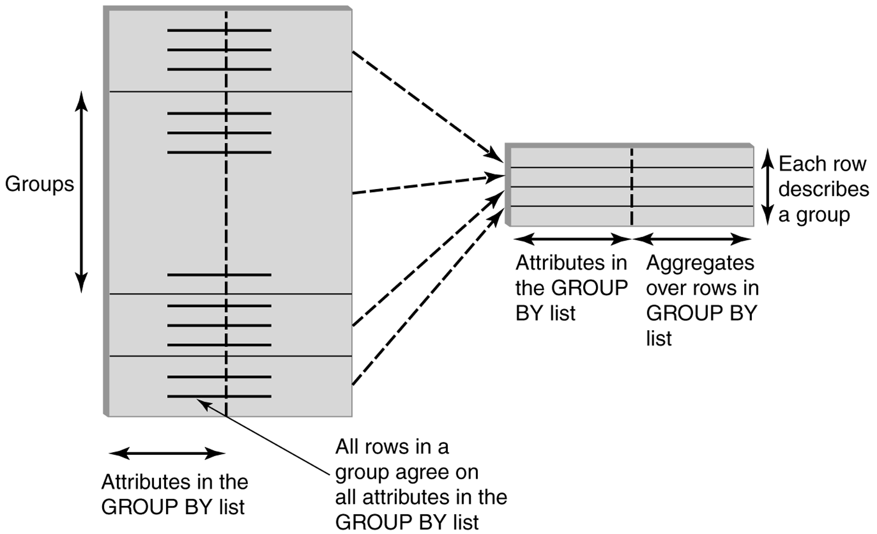
GROUP BY

Slide 58
GROUP BY - Example
Transcript
Attributes:
-student’s Id
-avg grade
-number of courses
1234
1234
1234
1234
1234 3.3 4
SELECT T.StudId, AVG(T.Grade), COUNT (*)
FROM Transcript T
GROUP BY T.StudId

Slide 59
HAVING Clause
Eliminates unwanted groups (analogous to WHERE clause)
HAVING condition constructed from attributes of GROUP BY list and aggregates of attributes not in list
SELECT T.StudId, AVG(T.Grade) AS CumGpa,
COUNT (*) AS NumCrs
FROM Transcript T
WHERE T.CrsCode LIKE ‘CS%’
GROUP BY T.StudId
HAVING AVG (T.Grade) > 3.5

Slide 60
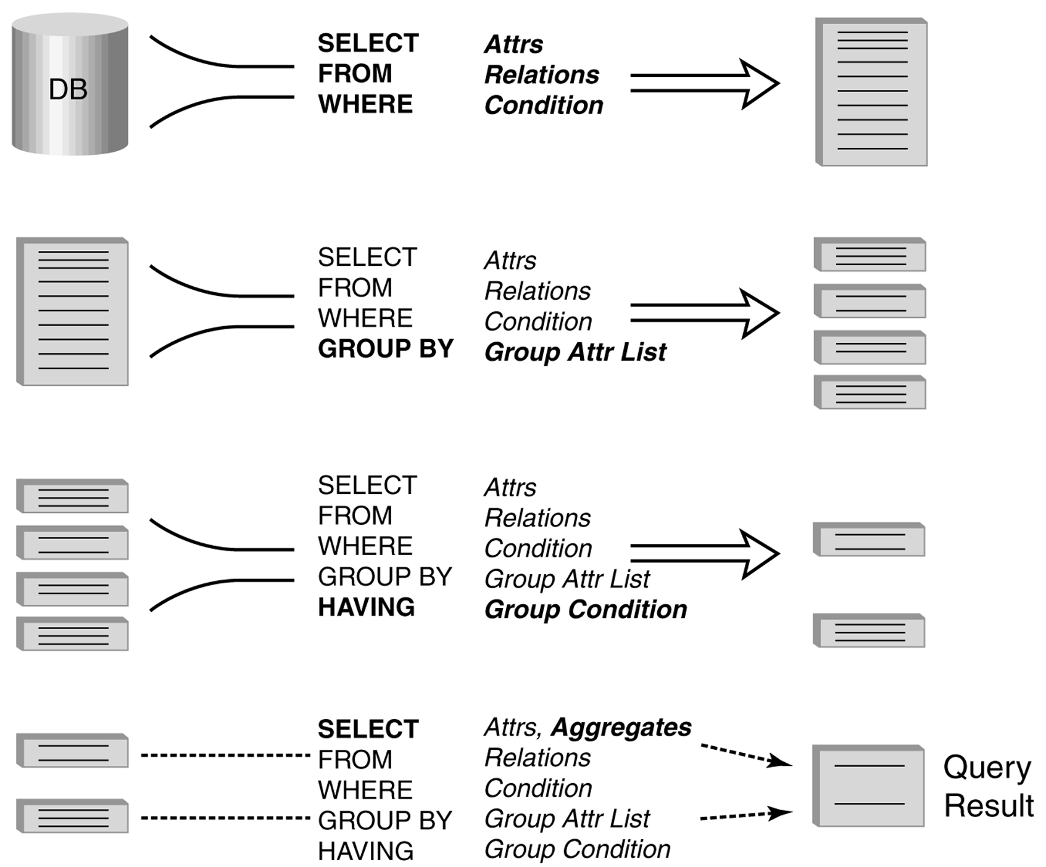
Evaluation of GroupBy with Having

Slide 61
Example
Output the name and address of all seniors on the Dean’s List
SELECT S.Name, S.Address
FROM Student S, Transcript T
WHERE S.StudId = T.StudId AND S.Status = ‘senior’
GROUP BY
HAVING AVG (T.Grade) > 3.5 AND SUM (T.Credit) > 90
S.StudId -- wrong
S.Name, S.Address -- right

Slide 62
ORDER BY Clause
Causes rows to be output in a specified order
SELECT T.StudId, COUNT (*) AS NumCrs,
AVG(T.Grade) AS CumGpa
FROM Transcript T
WHERE T.CrsCode LIKE ‘CS%’
GROUP BY T.StudId
HAVING AVG (T.Grade) > 3.5
ORDER BY DESC CumGpa, ASC StudId

Slide 63
Query Evaluation Strategy
Evaluate FROM: produces Cartesian product, A, of tables in FROM list
Evaluate WHERE: produces table, B, consisting of rows of A that satisfy WHERE condition
Evaluate GROUP BY: partitions B into groups that agree on attribute values in GROUP BY list
Evaluate HAVING: eliminates groups in B that do not satisfy HAVING condition
Evaluate SELECT: produces table C containing a row for each group. Attributes in SELECT list limited to those in GROUP BY list and aggregates over group
Evaluate ORDER BY: orders rows of C

Slide 64
Views
Used as a relation, but rows are not physically stored.
  The contents of a view is computed when it is used within an SQL statement
View is the result of a SELECT statement over other views and base relations
When used in an SQL statement, the view definition is substituted for the view name in the statement
  SELECT statement can be nested in FROM clause

Slide 65
View - Example
CREATE VIEW CumGpa (StudId, Cum) AS
SELECT T.StudId, AVG (T.Grade)
FROM Transcript T
GROUP BY T.StudId
SELECT S.Name, C.Cum
FROM CumGpa C, Student S
WHERE C.StudId = S.StudId AND C.Cum > 3.5

Slide 66
View Benefits
Access Control: Users not granted access to base tables. Instead they are granted access to the view of the database appropriate to their needs.
  External schema is composed of views.
  View allows owner to provide SELECT access to a subset of columns (analogous to providing UPDATE and INSERT access to a subset of columns)

Slide 67
Views - Limiting Visibility
CREATE VIEW PartOfTranscript (StudId, CrsCode, Semester) AS
SELECT T. StudId, T.CrsCode, T.Semester -- limit columns
FROM Transcript T
WHERE T.Semester = ‘S2000’ -- limit rows
GRANT SELECT ON PartOfTranscript TO joe
This is analogous to:
GRANT UPDATE (Grade) ON Transcript TO joe

Slide 68
View Benefits (con’t)
Customization: Users need not see full complexity of database. View creates the illusion of a simpler database customized to the needs of a particular category of users
A view is similar in many ways to a subroutine in standard programming
  Can be used in multiple queries

Slide 69
Nulls
Conditions: x op y (where op is <, >, <>, =, etc.) has value unknown (U) when either x or y is null
  WHERE T.cost > T.price
Arithmetic expression: x op y (where op is +, -, *, etc.) has value NULL if x or y is null
  WHERE (T. price/T.cost) > 2
Aggregates: COUNT counts nulls like any other value; other aggregates ignore nulls
SELECT COUNT (T.CrsCode), AVG (T.Grade)
FROM Transcript T
WHERE T.StudId = ‘1234’

Slide 70
Nulls (con’t)
WHERE clause uses a three-valued logic to filter rows. Portion of truth table:
Rows are discarded if WHERE condition is false or unknown
Ex: WHERE T.CrsCode = ‘CS305’ AND T.Grade > 2.5
C1 C2 C1 AND C2 C1 OR C2
T U U T
F U F U
U U U U

Slide 71
Modifying Tables - Insert
Inserting a single row into a table
  Attribute list can be omitted if it is the same as in CREATE TABLE (but do not omit it)
  NULL and DEFAULT values can be specified
INSERT INTO Transcript(StudId, CrsCode, Semester, Grade)
VALUES (12345, ‘CSE305’, ‘S2000’, NULL)

Slide 72
Bulk Insertion
Insert the rows output by a SELECT
CREATE TABLE DeansList (
StudId INTEGER,
Credits INTEGER,
CumGpa FLOAT,
PRIMARY KEY StudId )
INSERT INTO DeansList (StudId, Credits, CumGpa)
SELECT T.StudId, 3 * COUNT (*), AVG(T.Grade)
FROM Transcript T
GROUP BY T.StudId
HAVING AVG (T.Grade) > 3.5 AND COUNT(*) > 30

Slide 73
Modifying Tables - Delete
Similar to SELECT except:
  No project list in DELETE clause
  No Cartesian product in FROM clause (only 1 table name)
  Rows satisfying WHERE clause (general form, including subqueries, allowed) are deleted instead of output
DELETE FROM Transcript T
WHERE T.Grade IS NULL AND
T.Semester <> ‘S2000’

Slide 74
Modifying Data - Update
UPDATE Employee E
SET E.Salary = E.Salary * 1.05
WHERE E.Department = ‘research’
Updates rows in a single table
All rows satisfying WHERE clause (general form, including subqueries, allowed) are updated

Slide 75
Updating Views
Question: Since views look like tables to users, can they be updated?
Answer: Yes – a view update changes the underlying base table to produce the requested change to the view
CREATE VIEW CsReg (StudId, CrsCode, Semester) AS
SELECT T.StudId, T. CrsCode, T.Semester
FROM Transcript T
WHERE T.CrsCode LIKE ‘CS%’ AND T.Semester=‘S2000’

Slide 76
Updating Views - Problem 1
INSERT INTO CsReg (StudId, CrsCode, Semester)
VALUES (1111, ‘CSE305’, ‘S2000’)
Question: What value should be placed in attributes of underlying table that have been projected out (e.g., Grade)?
Answer: NULL (assuming null allowed in the missing attribute) or DEFAULT

Slide 77
Updating Views - Problem 2
INSERT INTO CsReg (StudId, CrsCode, Semester)
VALUES (1111, ‘ECO105’, ‘S2000’)
Problem: New tuple not in view
Solution: Allow insertion (assuming the WITH CHECK OPTION clause has not been appended to the CREATE VIEW statement)

Slide 78
Updating Views - Problem 3
Update to the view might not uniquely specify the change to the base table(s) that results in the desired modification of the view
CREATE VIEW ProfDept (PrName, DeName) AS
SELECT P.Name, D.Name
FROM Professor P, Department D
WHERE P.DeptId = D.DeptId

Slide 79
Updating Views - Problem 3 (con’t)
Tuple <Smith, CS> can be deleted from ProfDept by:
  Deleting row for Smith from Professor (but this is inappropriate if he is still at the University)
  Deleting row for CS from Department (not what is intended)
  Updating row for Smith in Professor by setting DeptId to null (seems like a good idea)

Slide 80
Updating Views - Restrictions
Updatable views are restricted to those in which
  No Cartesian product in FROM clause
  no aggregates, GROUP BY, HAVING
  …
For example, if we allowed:
CREATE VIEW AvgSalary (DeptId, Avg_Sal ) AS
SELECT E.DeptId, AVG(E.Salary)
FROM Employee E
GROUP BY E.DeptId
then how do we handle:
UPDATE AvgSalary
SET Avg_Sal = 1.1 * Avg_Sal

